Slide 1
Dr Jean-Frederic Levesque
Chief Executive, Bureau of Health Information

Slide 2
BHI’s purpose
To provide the community, healthcare professionals and the NSW Parliament with independent, timely and accurate information about the performance of the NSW public health system in ways that enhance the system’s accountability and inform efforts to improve health care.

Slide 3
Reporting to promote accountability
Patient empowerment
Supporting patients’ choices and expectations
Promotes accountability at the patient-provider interface
Political debate
Stimulating explicit debates about policies
Supports a culture of openness about performance

Slide 4
Reporting to support improvement
Internal motivation
Knowing about own performance is a starting point
Seeing the performance of others reinforces
External pressure
Contracts, funding streams and policies
Peer judgement and public pressure

Slide 5
Clinically-relevant dimensions of performance
Productivity: being organised, doing more
Accessibility: healthcare, when and where needed
Appropriateness: the right healthcare, the right way
Effectiveness: making a difference for patients

Slide 6
Policy-relevant dimensions of performance
Efficiency: value for money
Equity: health for all; healthcare that’s fair
Sustainability: caring for the future
Impact: better health, better lives

Slide 7
BHI’s reports
Healthcare in Focus – Annual Performance Report
Hospital Quarterly
The Insights Series
Patient Perspectives
Spotlight on Measurement
Data Matters
Snapshots Series

Slide 8
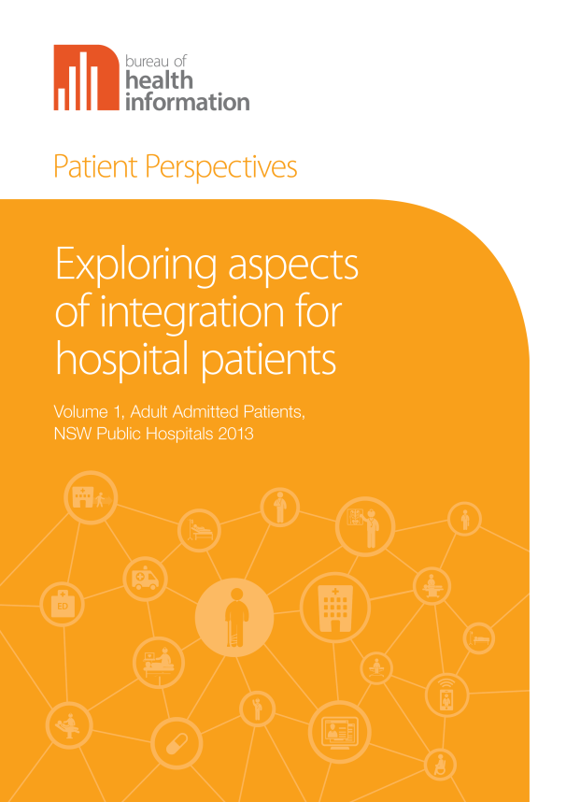
Our latest reports

Slide 9
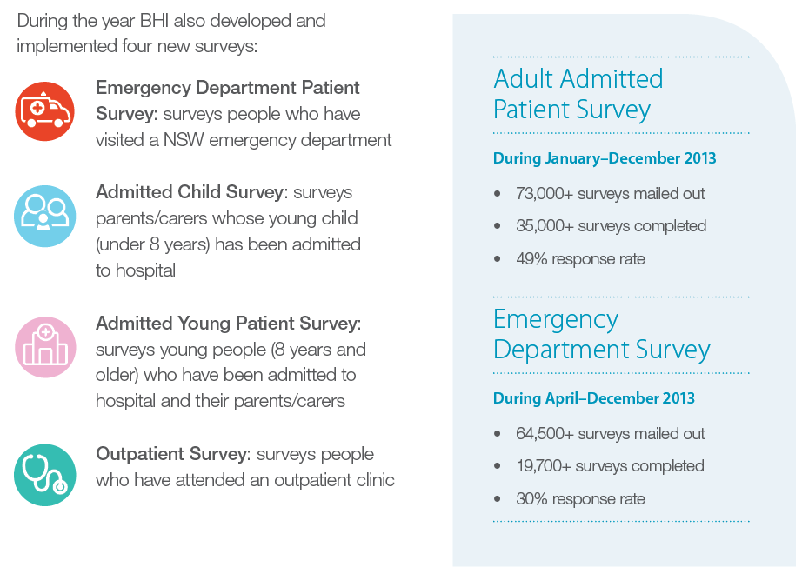
NSW Patient Survey Program

Slide 10
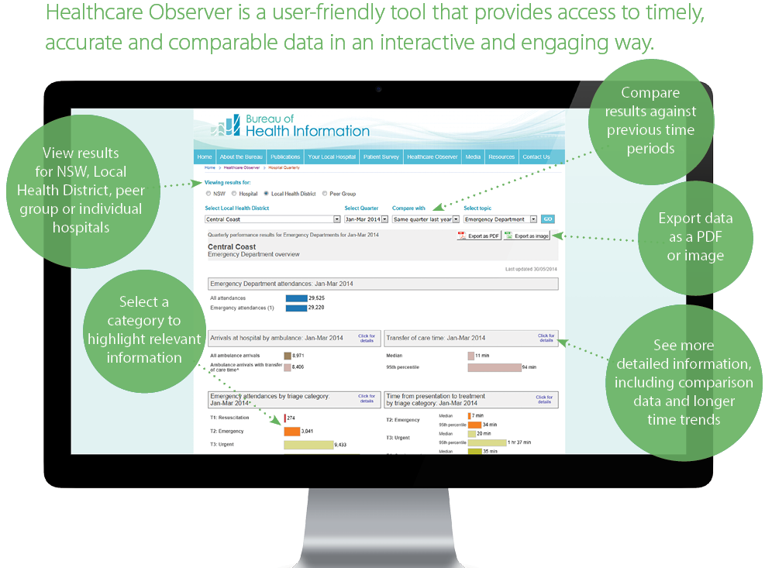
Healthcare Observer

Slide 12
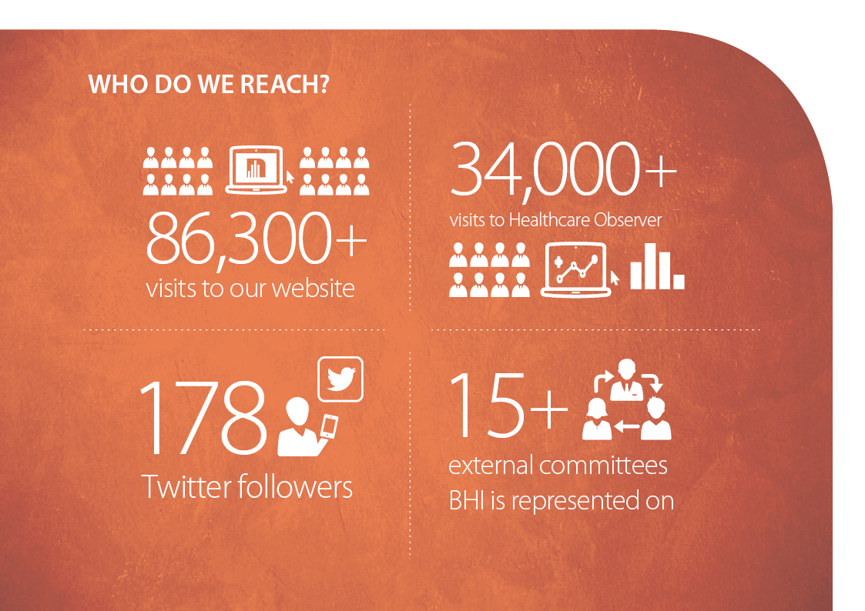

Slide 14
More timely, detailed and tailored informaton – increased digital data, interactive media and advanced visualisation
Provide clinicians and managers access to more detailed information to support their local decision-making
Develop new measures that are linked to priority areas for NSW Public Health System
Stronger measures of outcomes of care
More information about clinical variations in acute and chronic care
Greater focus on what patients have to say about their care and how it impacts their life
Insights into how providers and delivery organisations work as a system

