Slide 1
CHART PACK
Commonwealth Fund International Health Policy Survey 2016
How does NSW compare?

Slide 2
About this chart pack
    The 2016 Commonwealth International Health Policy survey focused on experiences of adults aged 18 years and over regarding: health care costs; access to care; coordination; patient-centeredness of care, and chronic care management in 11 countries. The survey also contains a representative sample of NSW.
    This chart pack highlights selected results for NSW that were presented as part of Healthcare in Focus 2016: How does NSW compare?, as part of a broader look at healthcare performance in NSW.
    Supplementary data tables are available on BHI’s website bhi.nsw.gov.au, providing full information on the survey and more detailed responses to the questions presented in this chart pack and in the Healthcare in Focus report.
Notes:
For the Healthcare in Focus 2016 report, Technical Supplement, and Excel tables with full set of questions and country differences see our website: http://www.bhi.nsw.gov.au/BHI_reports/healthcare_in_focus/2016

Slide 3
Data source
  The 2016 Commonwealth International Health Policy survey of adults was conducted by telephone between March and June 2016, and captured responses of 3,835 adults in NSW.
  The sample is selected and survey weights are used in producing all findings so that results are representative of the age, sex, education, and regional profile of NSW.
 | Landline | Cell phone | Combined response rate | Number of respondents
Australia | 23.7% | 27.8% | 25.4% | 5,248
NSW | - | - | - | 3,835
Canada | 23.1% | 16.9% | 21.4% | 4,547
France | 24.5% | 26.8% | 25.2% | 1,103
Germany | 27.0% | 26.6% | 26.9% | 1,000
Netherlands | 32.4% | 32.4% | 32.4% | 1,227
New Zealand | 35.2% | 23.4% | 31.1% | 1,000
Norway | 10.6% | 11.0% | 10.9% | 1,093
Sweden | 17.6% | 16.4% | 16.9% | 7,124
Switzerland | 86% of respondents by web |  | 46.9% | 1,520
United Kingdom | 26.1% | 13.9% | 21.9% | 1,000
United States | 19.4% | 17.2% | 18.1% | 2,001

Slide 4
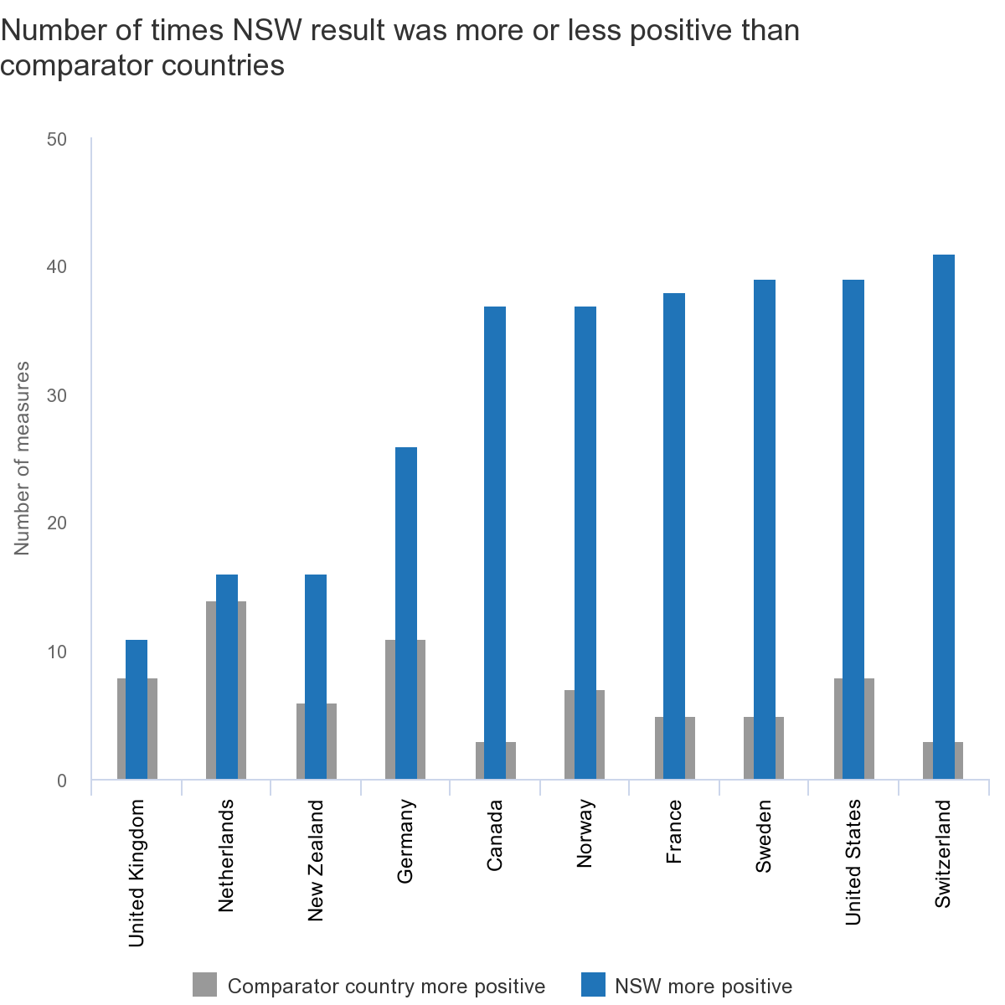
NSW healthcare compared to 10 countries
across 56 survey questions

Slide 5
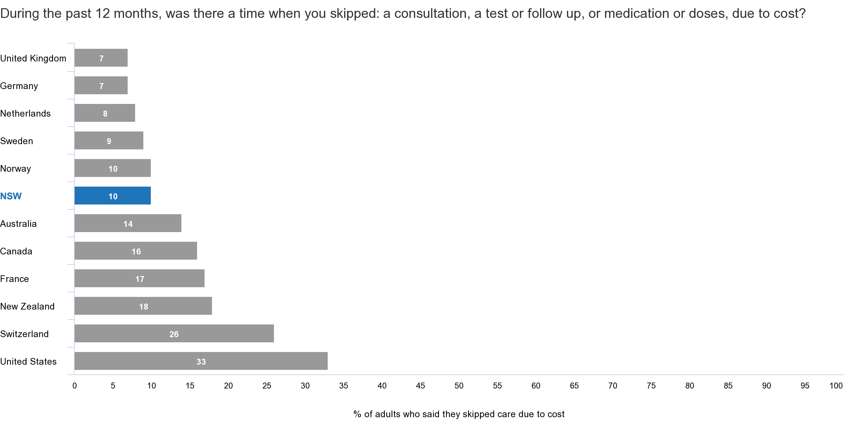
One in 10 NSW adults said they skipped care
due to cost

Slide 6
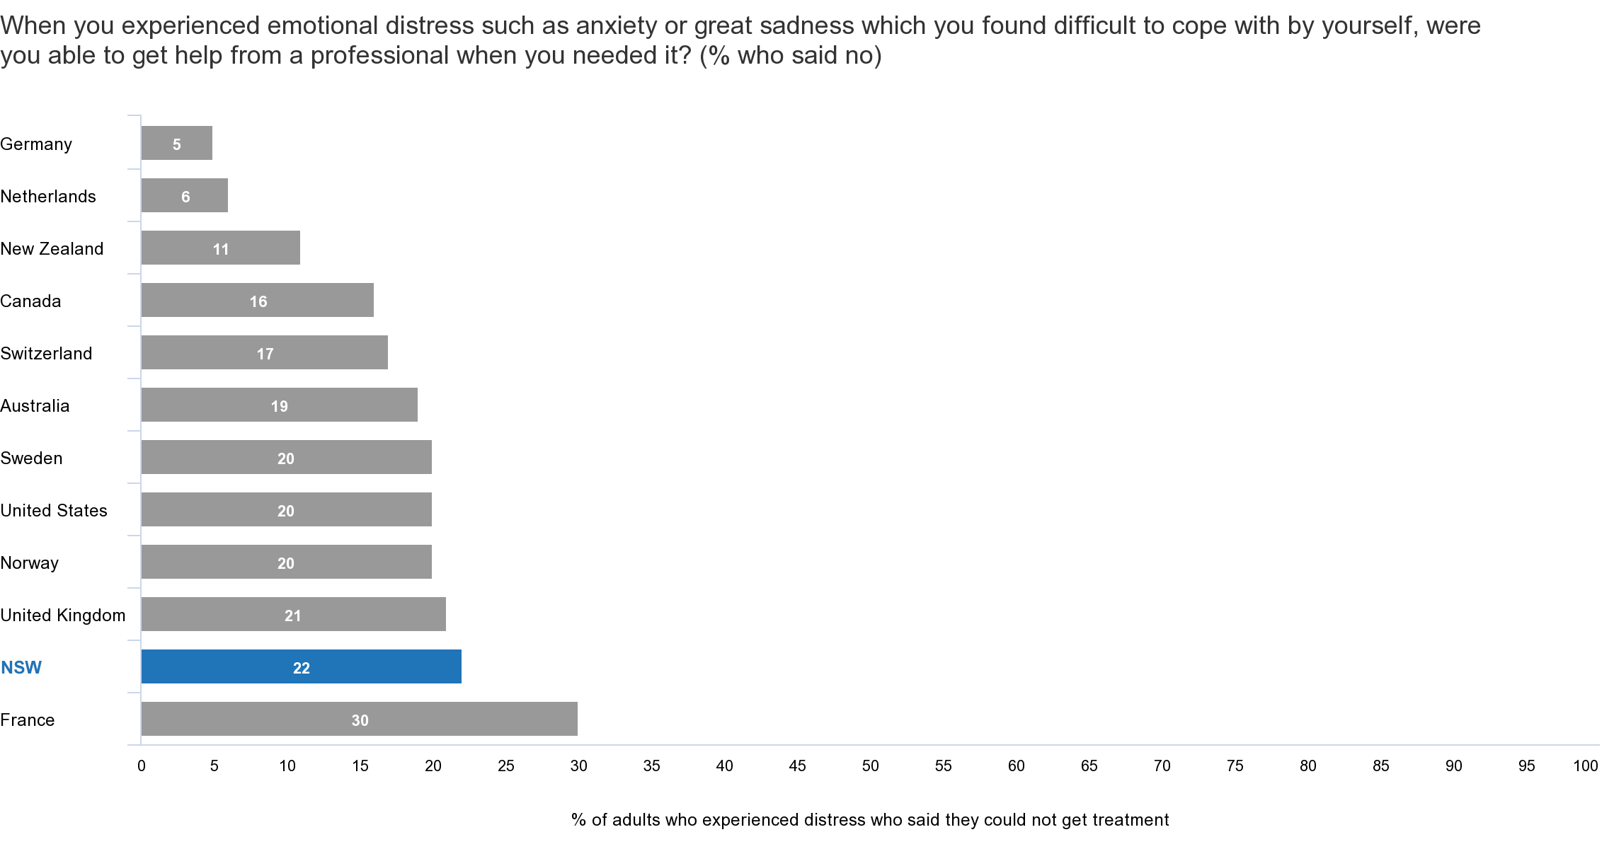
One in five NSW adults who experienced
emotional distress could not get help

Slide 7
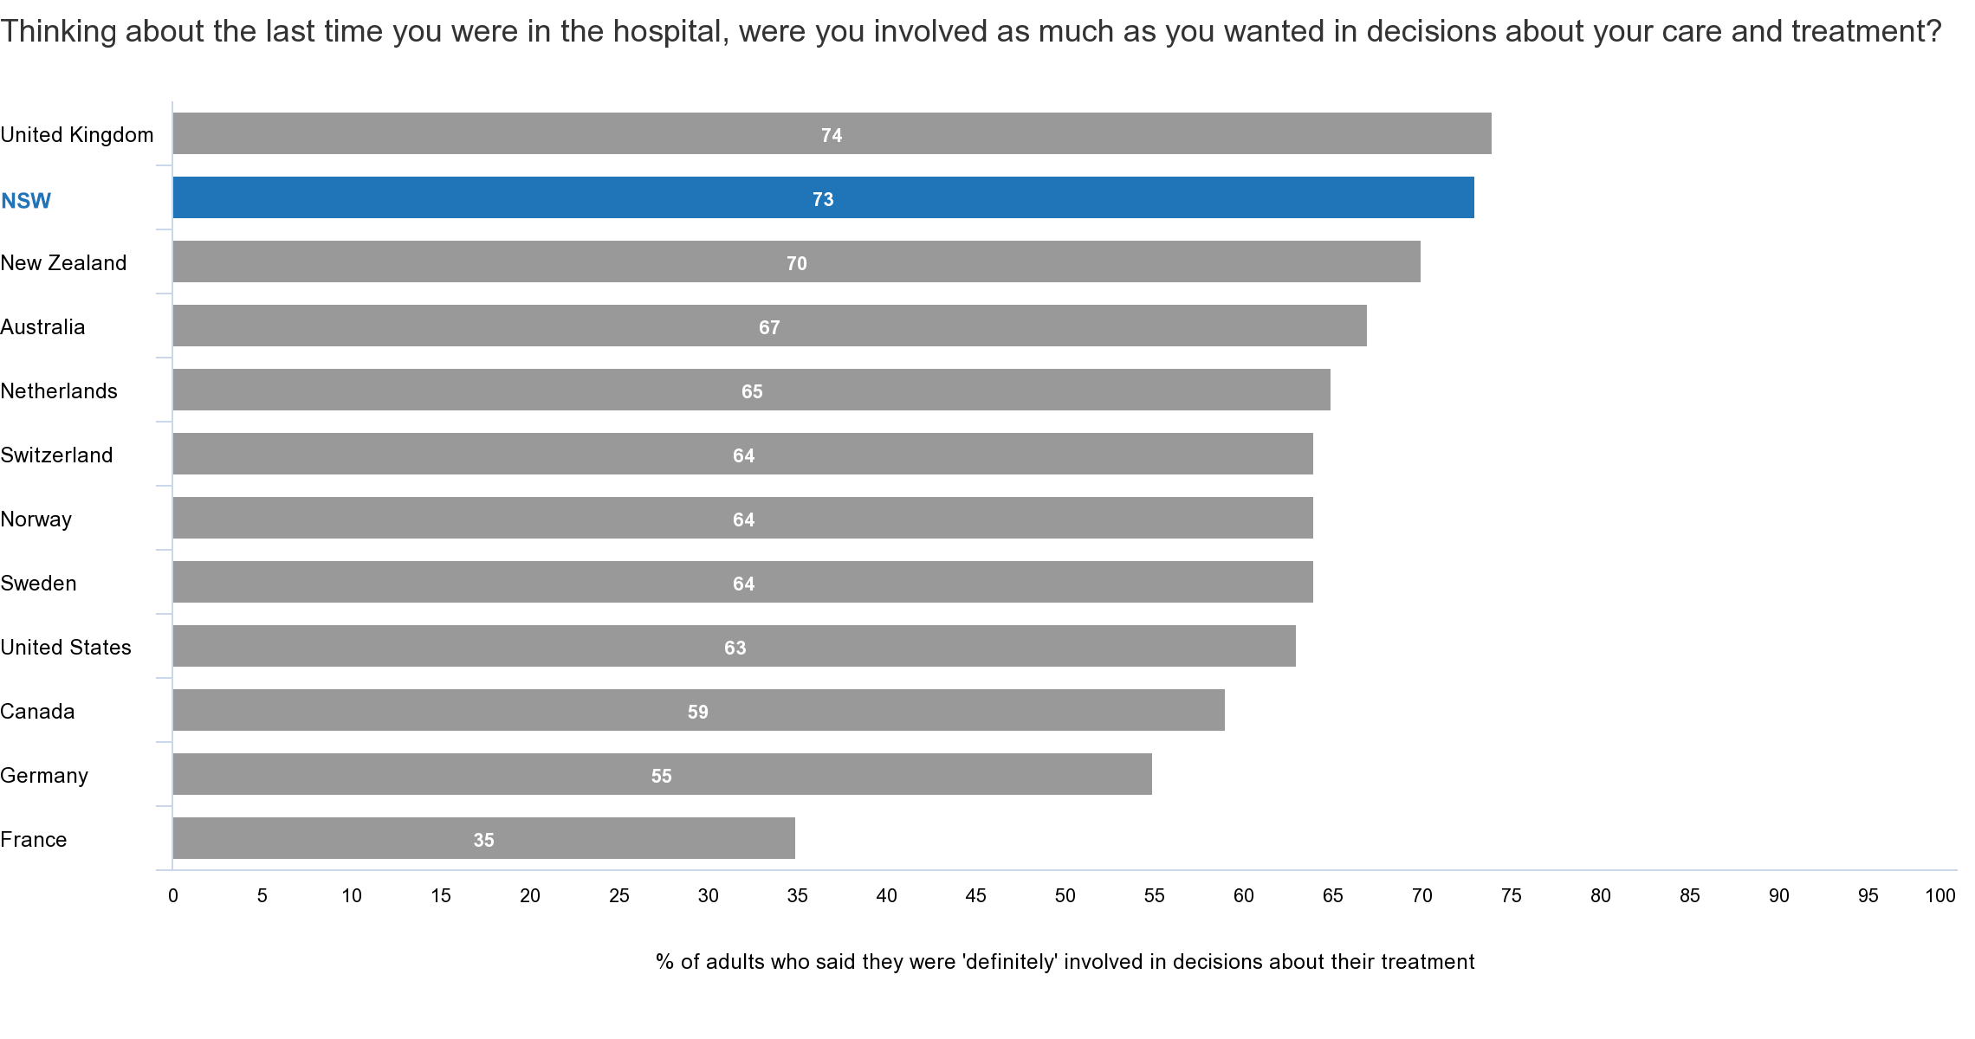
Seven in 10 NSW patients were ‘definitely’ involved in decisions about their care

Slide 8
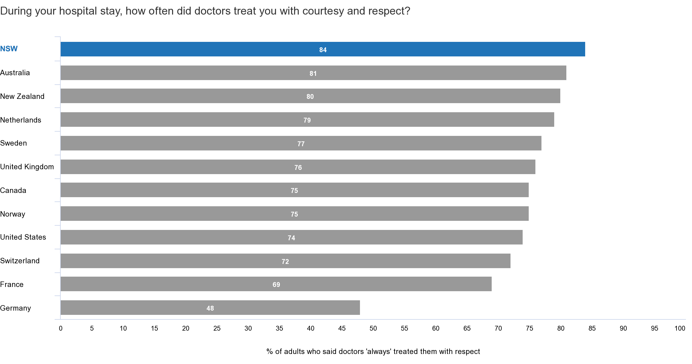
Most NSW patients experienced courteous
and respectful care

