Slide 1
Experiences of patients from culturally and linguistically diverse backgrounds
25th Cancer Nurses Society of Australia Annual Congress
Findings from the 2021 survey of NSW outpatient cancer clinics
Lilian Daly, A/Director Performance Reports
June 2023

Slide 2
Acknowledgement of country
We acknowledge the traditional custodians of the lands upon which we are meeting today.
We honour the ancestors of yesterday, the custodians of today and those of tomorrow. We recognise the continuing connection to land and waters, and how culture is held, nurtured and shared. We pay our respects.

Slide 3


Bureau of Health Information
The Bureau of Health Information (BHI) is a board-governed organisation that provides the community, healthcare professionals and policy makers with information that enhances transparency of the performance of the healthcare system in NSW to inform actions to improve healthcare and strengthen accountability.
Trusted information. Informed decisions. Improved healthcare.
BHI is a trusted provider of health performance information
Information is used to inform action
Patients’ experiences and outcomes continue to improve

Slide 4
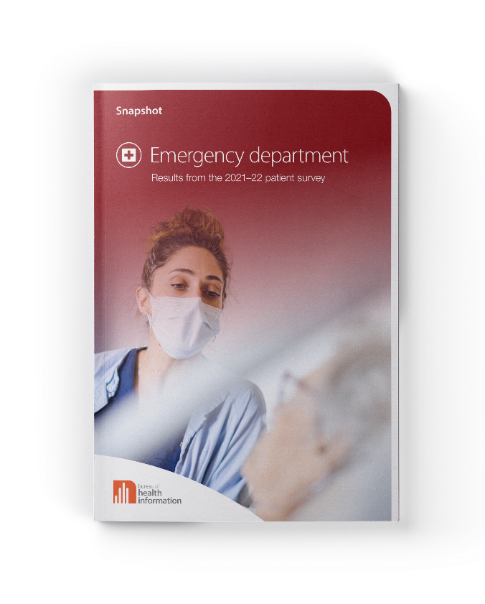
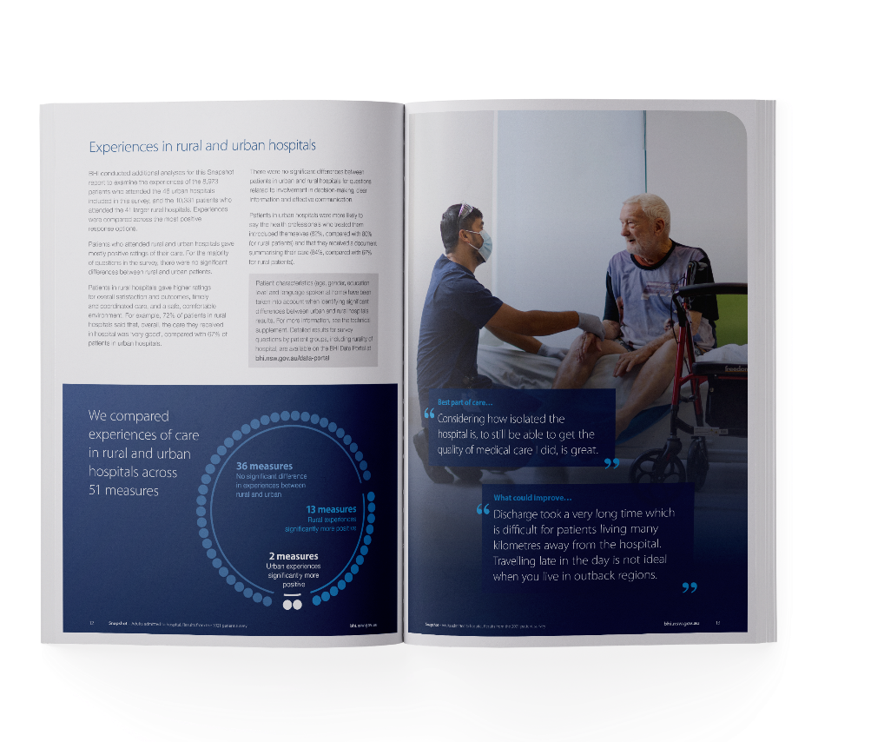

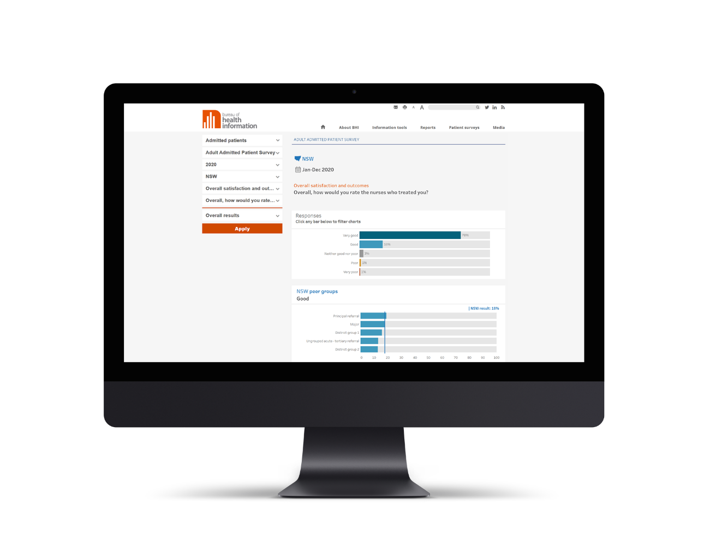


BHI’s core reporting
BHI reports and information products are available at bhi.nsw.gov.au

Slide 5


What we do
NSW Patient Survey Program
BHI survey results help gauge strategic progress and identify improvement priorities at system, local health district and hospital level. They are complementary to other patient feedback.
Reflections on whole journeys and episodes of care
Systematically collected, providing statistically valid benchmarks and trends
Thousands of verbatim patient comments
Patient experience KPIs
Results reported publicly

Slide 6
NSW Patient Survey Program
The NSW Patient Survey Program covers many areas of our State’s public health system, such as:
Patients admitted to hospital
Emergency
departments
Maternity care
Outpatient cancer
clinics
Virtual Care Survey
Rural Hospital Adult Admitted Patients
Rural Hospital Emergency Care Patients
—
~19,000 respondents
87 hospitals
—
~22,000 respondents
77 hospitals
—
~4,500 respondents
68 hospitals
—
~8,000 respondents
42 facilities
—
~2,500 respondents
—
~6,500 respondents
90 hospitals
—
~6,000 respondents
65 hospitals
Surveys cover domains of patient experience, including:
Overall satisfaction and outcomes
Compassion, respect and kindness
Trust and confidence
Effective communication
Safe, comfortable environment
All BHI surveys and results are available at bhi.nsw.gov.au

Slide 7
NSW Outpatient Cancer Clinics Survey
Delivered in partnership with the Cancer Institute NSW (CINSW) since 2015
Asks people about their experiences attending one of more than 40 clinics in NSW
Questions cover overall experiences of care, processes of care, experiences across key patient experience domains, and virtual care module
Include core ‘Performance’ questions – results attributable to facility
Results are reported annually in the Reporting for Better Cancer Outcomes program
BHI also reports the results publicly in annual Snapshot reports and on the BHI Data Portal

Slide 8
Outpatient Cancer Clinics Survey
Survey of 8,323 patients who attended one of 42 NSW outpatient cancer facilities in November 2021, including three private facilities (response rate 40%).
Snapshot report:
Highlights results for key areas of care, at NSW and facility level
Additional findings based on analyses comparing experiences of 916 (15%) respondents who speak a language other than English at home with those of English speakers

Slide 9
Culturally and linguistically diverse (CALD) groups in Australia
Three in 10 people living in Australian were born overseas. More than one in four people in NSW born overseas
One in three people in NSW speaks a language other than English at home and nearly one in 20 does not speak English well or at all
People from culturally and linguistically diverse (CALD) backgrounds face greater challenges when dealing with the health and welfare system
Language barriers, lower health literacy, and difficulties navigating an unfamiliar system put them at greater risk of poorer quality health care, service delivery and poorer health outcomes compared with other Australians

Slide 10
Methodology

Slide 11
Analyses of differences in patient experiences
Logistic regression model was used with adjustment for confounders and sampling
Patient characteristics (age, gender, education level, and cancer type/non-cancer patient) were taken into account when identifying significant differences
A p-value of 0.05 was used to determine if the differences were statistically significant

Slide 12
Key findings

Slide 13
Experiences of patients who speak a language other than English at home

Slide 14
Overall satisfaction and outcomes

Slide 15
Timely and coordinated care

Slide 17
Information and communication

Slide 19
Compassion, respect and kindness

Slide 20
Safe, comfortable environment

Slide 21
Access and timeliness

Slide 22
Conclusions
Each year in NSW, thousands of patients from CALD backgrounds, and who speak a language other than English at home visit cancer outpatient clinics
Our results confirm that there are several opportunities for improving the experiences and outcomes of care for patients who visit NSW outpatient cancer clinics and who speak a language other than English at home include focussing on clear information, timely and coordinated care and compassionate, kind and respectful care
In October 2023, BHI will release in in-depth Insights report on experiences of care in NSW public hospital and healthcare services of people who speak a language other than English at home

Slide 23
Thank you
Lilian.Daly@health.nsw.gov.au
Notes:
Thanks for listening – happy to take any questions.

